Slide 1
DevOps: Engineering for Deployment and Operations
Len Bass
Notes:
Lead with motivating examples – Knight Capital, Goldman Sachs, Azure outage caused by certificates, Delta ticket pricing, cycle time requirements

Slide 2
Context for course
This course is a portion of the CMU MSE professional master’s program
Students are graduate students at CMU. Some have industrial experience, some right out of undergraduate school
The course is an elective and students take one elective per semester
Currently in the fourth offering of the course
© Len Bass 2015

Slide 3
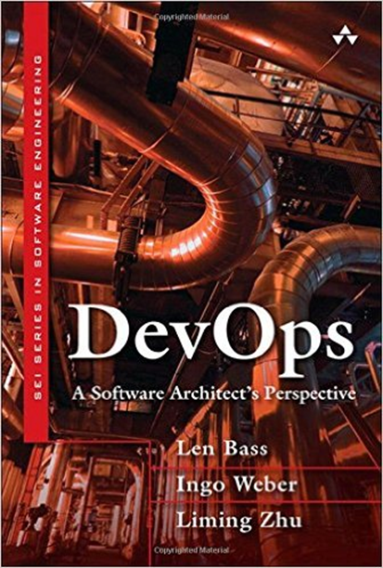
Course structure
Half theory
  Lectures on video to be seen prior to class
  Textbook and other readings
  In class discussion about lectures and readings
Half exercises
    Exercises involve a variety of open source tools
  Evaluation based on theory and exercises
© Len Bass 2015

Slide 4
Discussion examples
What was your takeaway from the videos?
  Each student is called on
Generate a design of a relevant tool, e.g. Continuous Integration server
  Done in groups
Time in discussion matches time in video
  Balances out of class reading/video with inclass time spent discussing
© Len Bass 2015

Slide 5
Syllabus
You can retrieve the syllabus from
https://github.com/devopseducator/2016workshop/blob/master/cmu%2017-611%20syllabus.pdf
© Len Bass 2015

Slide 6
Elaborating on the syllabus - background
it is amazing what graduate students in CS at CMU do not know. A reflection of their undergraduate curriculum.
Virtualization
  Virtual machines
  Virtual machine images
Networks
  IP addresses
  DNS servers and TTL (time to live)
  Ports
  Load Balancers
© Len Bass 2015

Slide 7
Deployment pipeline
Introduction to a deployment pipeline
What are the roles and responsibilities of various teams with respect to the pipeline
Case study in business continuity
Environments of the pipeline in more detail with types of tests
  Development
  Build
  Staging
  Production
Case study of company that sets up continuous deployment pipelines
© Len Bass 2015

Slide 8
Elaborating on the syllabus – architecture and advanced packaging
Microservice architecture
Case study in migrating to a microservice architecture
Containers
© Len Bass 2015

Slide 9
Elaborating on the syllabus – cloud
Failures in the cloud
Distributed coordination – Zookeeper, Consul
Scalability
© Len Bass 2015

Slide 10
Elaborating on the syllabus – deployment
Designing for deployment
  Use of feature toggles
  Backward and forward compatability
  Managing schemas
© Len Bass 2015

Slide 11
Elaborating on the syllabus – security
Basic security
Credential management
Securing the network
Securing the pipeline
Securing an app
© Len Bass 2015

Slide 12
Elaborating on the syllabus – monitoring
What to monitor
How to monitor
Interpreting monitoring data
© Len Bass 2015

Slide 13
Assignments
Virtualization using VirtualBox
SSH
Vagrant
Jenkins
Chef
Docker
AWS EC2 Container Service
Chef Vault
Nagios
© Len Bass 2015

Slide 14
Conclusion
DevOps has three facets
  Automation
  Process
  Design
The theory focuses more on design, the assignments more on automation.
Process is implicit but not explicitly covered.
© Len Bass 2015

